Slide 1
Lecture 02
Hash Tables

Slide 2
Hash Table ADT
The hash table is a table of elements that have keys
A hash function is used for locating the position of a key in the table
A search for an element can be done in Θ( 1 ) time.

Slide 3
Selected Hash Table ADT Operations
insert, to insert an element into a table
retrieve, to retrieve an element from the table
an operation to empty out the hash table

Slide 4
Hash Functions
The input into a hash function is a key value
The output from a hash function is an index of an array (hash table) where the object containing the key is located
Example of a hash function:
h( k ) = k % table_size

Slide 5
Example Using a Hash Function
Suppose our hash function is:
h( k ) = k % 100
We wish to search for the object containing key value 214
k is set to 214 in the hash function
The result is 14
The object containing key value 214 is stored at index 14 of the array (hash table)
The search is done in Θ( 1 ) time

Slide 6
Inserting an Element
An element is inserted into a hash table using the same hash function
h( k ) = k % 100
To find where an element is to be inserted, use the hash function on its key
If the key value is 214, the object is to be stored in index 14 of the array
Insertion is done in Θ( 1 ) time

Slide 7
Consider the Big Picture …
If we have one million key values
Linear search takes O( n ) to search in a regular array or a linked list
On average, we might compare 500,000 key values
Binary search algorithm gives O(lg n)
lg 500000 ≈ 19
Number of comparison:
1 (hashtable) vs. 19 (binary search) vs. 500,000 (linear search)

Slide 8
Collisions
Consider the hash function
h( k ) = k % 100
A key value of 393 is used for an object, and the object is stored at index 93
Then a key value of 193 is used for a second object; the result of the hash function is 93, but index 93 is already occupied
This is called a collision
The most popular way to resolve collisions is by chaining, linear probing, and other methods

Slide 9
Collision Resolution: Chaining
In chaining, instead of having an array of objects, we have an array of linked lists, each node of which contains an object
An element is still inserted by using the hash function -- the hash function provides an index of a linked list, and the element is inserted at the front of that (usually short) linked list
When searching for an element, the hash function is used to get the correct linked list, then the linked list is searched for the key
Java’s HashSet and HashMap are hash tables that use chaining for collision resolution

Slide 10
Example Using Chaining
0
1
2
3
4
5
6
A hash table which is initially empty.
Every element is a LinkedList object. Only the start pointer of the LinkedList object is shown, which is set to NULL.
The hash function is:
h( k ) = k % 7
Table/Array size is 7

Slide 11
Example Using Chaining (cont.)
0
1
2
3
4
5
6
INSERT object with key 31
31 % 7 is 3
The hash function is:
h( k ) = k % 7

Slide 12
Example Using Chaining (cont.)
0
1
2
3
4
5
6
Note: The whole object is stored but only the key value is shown
INSERT object with key 31
31 % 7 is 3
31
The hash function is:
h( k ) = k % 7

Slide 13
Example Using Chaining (cont.)
0
1
2
3
4
5
6
9
INSERT object with key 9
9 % 7 is 2
31
The hash function is:
h( k ) = k % 7

Slide 14
Example Using Chaining (cont.)
0
1
2
3
4
5
6
36
9
INSERT object with key 36
36 % 7 is 1
31
The hash function is:
h( k ) = k % 7

Slide 15
Example Using Chaining (cont.)
0
1
2
3
4
5
6
42
36
9
INSERT object with key 42
42 % 7 is 0
31
The hash function is:
h( k ) = k % 7

Slide 16
Example Using Chaining (cont.)
0
1
2
3
4
5
6
42
36
9
INSERT object with key 46
46 % 7 is 4
31
46
The hash function is:
h( k ) = k % 7

Slide 17
Example Using Chaining (cont.)
0
1
2
3
4
5
6
42
36
9
INSERT object with key 20
20 % 7 is 6
31
46
The hash function is:
h( k ) = k % 7
20

Slide 18
Example Using Chaining (cont.)
0
1
2
3
4
5
6
42
COLLISION occurs…
36
9
INSERT object with key 2
2 % 7 is 2
31
46
The hash function is:
h( k ) = k % 7
20

Slide 19
Example Using Chaining (cont.)
0
1
2
3
4
5
6
42
But key 2 is just inserted in the linked list
36
9
INSERT object with key 2
2 % 7 is 2
31
46
The hash function is:
h( k ) = k % 7
20

Slide 20
Example Using Chaining (cont.)
0
1
2
3
4
5
6
42
The insert function of LinkedList inserts a new element at the BEGINNING of the list
36
9
INSERT object with key 2
2 % 7 is 2
31
46
The hash function is:
h( k ) = k % 7
20

Slide 21
Example Using Chaining (cont.)
0
1
2
3
4
5
6
42
36
9
2
INSERT object with key 2
2 % 7 is 2
31
46
The hash function is:
h( k ) = k % 7
20

Slide 22
Example Using Chaining (cont.)
0
1
2
3
4
5
6
42
36
9
2
INSERT object with key 24
24 % 7 is 3
31
24
46
The hash function is:
h( k ) = k % 7
20

Slide 23
Example Using Chaining (cont.)
0
1
2
3
4
5
6
42
36
9
2
**FIND** the object with key 2
2 % 7 is 2
31
24
46
The hash function is:
h( k ) = k % 7
20

Slide 24
Example Using Chaining (cont.)
0
1
2
3
4
5
6
42
We search this linked list for the object with key 2
36
9
2
**FIND** the object with key 2
2 % 7 is 2
31
24
46
The hash function is:
h( k ) = k % 7
20

Slide 25
Example Using Chaining (cont.)
0
1
2
3
4
5
6
42
Remember…the whole object is stored, only the key is shown
36
9
2
**FIND** the object with key 2
2 % 7 is 2
31
24
46
The hash function is:
h( k ) = k % 7
20

Slide 26
Example Using Chaining (cont.)
0
1
2
3
4
5
6
42
Does this object contain key 2?
36
9
2
**FIND** the object with key 2
2 % 7 is 2
31
24
46
The hash function is:
h( k ) = k % 7
20

Slide 27
Example Using Chaining (cont.)
0
1
2
3
4
5
6
42
Does this object contain key 2? No, so go on to the next object.
36
9
2
**FIND** the object with key 2
2 % 7 is 2
31
24
46
The hash function is:
h( k ) = k % 7
20

Slide 28
Example Using Chaining (cont.)
0
1
2
3
4
5
6
42
Does this object contain key 2?
36
9
2
**FIND** the object with key 2
2 % 7 is 2
31
24
46
The hash function is:
h( k ) = k % 7
20

Slide 29
Example Using Chaining (cont.)
0
1
2
3
4
5
6
42
Does this object contain key 9? YES, found it! Return the object.
36
9
2
**FIND** the object with key 9
9 % 7 is 2
31
24
46
The hash function is:
h( k ) = k % 7
20

Slide 30
Clustering in Chaining
Some indexes are crowded but most indexes are empty
Thus, some linked lists are empty while some linked lists have long chain
Worst case is O(n) where n is the max length of the chain

Slide 31
Open Addressing
Chaining requires additional memory for linked list
If saving memory is important, we could store the elements directly in the array without creating linked list
Known as open addressing
Linear probing and quadratic probing are examples of open addressing strategy

Slide 32
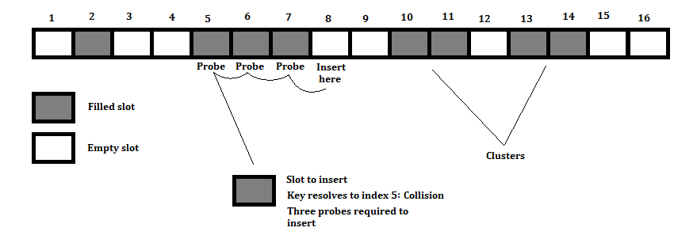
Collision Resolution: Linear Probing
If collision, put the element on the next free slot
In the above case, collision at index 5, index 6,7 is filled, thus put the item at index 8.

Slide 33
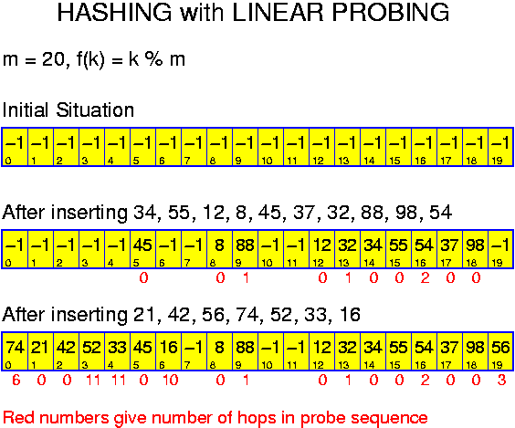
Hashing Linear Probing Problem
When inserting 56, we hit index 16, we need to probe till index 19 (3 probes) before we can insert 56.

Slide 34
Clustering in Linear Probing
Some consecutive indexes are occupied while some consecutive indexes are empty
Thus, some consecutive array slots are occupied while some consecutive array slots are empty
Worst case is O(n) where n is the length of the array

Slide 35
Linear Probing improvement Quadratic Probing
Rather than always moving one cell (linear probing) when encounters collision, this strategy moves j² cells from the point of collision, j is the number of attempts to resolve the collision
The limitation of this strategy: It may not find an empty cell, if the bucket array is at least half full

Slide 36
Quadratic Probing
m = 10, f(k) = k % m
Initial hashtable:
Inserting 27, 17, 37, 47, 48, 57:
27%10 = 7
17%10 = 7 (Collision: 7+1²=8, 8%10 = 8)
37%10 = 7 (Collision: 7+2²=11, 11%10 = 1)
47%10 = 7 (Collision: 7+3²=16, 16%10 = 6)
48%10 = 8 (Collision: 8+1²=9, 9%10 = 9)
57%10 = 7 (Collision: 7+4²=23, 23%10 = 3)
After Insertion:
0 | 1 | 2 | 3 | 4 | 5 | 6 | 7 | 8 | 9
 | 37 |  | 57 |  |  | 47 | 27 | 17 | 48
0 | 1 | 2 | 3 | 4 | 5 | 6 | 7 | 8 | 9
36
Notes:
36

Slide 37
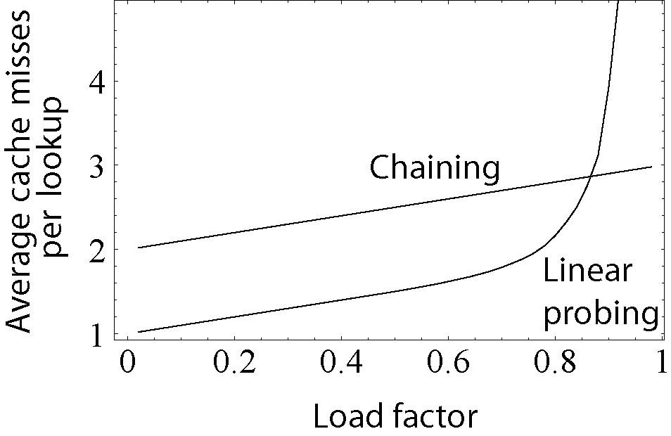
Chaining vs Linear Probing

Slide 38
Chaining vs. Linear Probing
Linear Probing uses fixed amount of memory, Chaining requires extra memory for linked lists
Linear probing is better suited for caching, when you load an item, the next item is always loaded
Clustering does happen for both techniques, but linear probing search time is longer if there are many collisions
Linear Probing is better if the load factor is lower than 0.85

Slide 39
Uniform Hashing
When the elements are spread evenly (or near evenly) among the indexes of a hash table, it is called uniform hashing
If elements are spread evenly, such that the number of elements at an index is less than some small constant, uniform hashing allows Θ( 1 ) time for a search in both chaining and open addressing, but still O( n ) time for a miss in open addressing

Slide 40
Ideal Hash Function for Uniform Hashing
The hash function largely determines whether we will have uniform hashing
One possible solution is to have the hash table size a prime number that is not too close to a power of 2
31 is a prime number but is too close to a power of 2
97 is a prime number not too close to a power of 2
A good hash function might be:
h( k ) = k % 97

Slide 41
Ideal Hash Tables
Can we have a hash function which guarantees that there will be no collisions?
Yes:
h( k ) = k
Each key k is unique; therefore, each index produced from h( k ) is unique
Consider 300 employees that have a 4-digit unique id, a hash table size of 10,000 guarantees the best possible speed. However, 97% of the hash table (9,700 slots) are empty hence wasting space

Slide 42
Ideal Hash Tables (cont.)
Can we have a hash table without any collisions and without any empty slots?
Sometimes. Consider 300 employees with id from 0 to 299. We can make a hash table size of 300, and use h( k ) = k

Slide 43
Speed vs. Memory Conservation
The greatest speed comes about by making a hash table much larger than the number of keys so that there is no collision
The best memory conservation comes from trying to reduce the number of empty slots

Slide 44
Hash Table Design
Decide whether speed or memory conservation is more important (and how much more important) for the application
Come up with a good table size which
Allows for the use of a good hash function
Strikes the appropriate balance between speed and memory conservation

Slide 45
Time Complexities for Hash Table
insert – we’ll insert at the head of the linked list – Θ( 1 )
retrieve – element is found by hashing, so it is Θ( 1 ) for uniform hashing (the hash function and hash table are designed so that the length of the collision list is bounded by some small constant)

